Slide 1
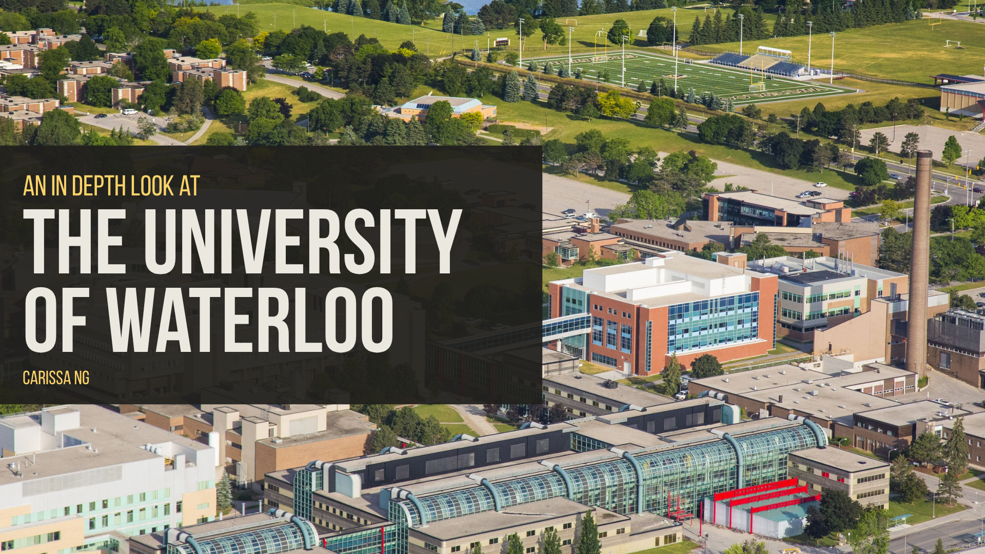

Slide 2
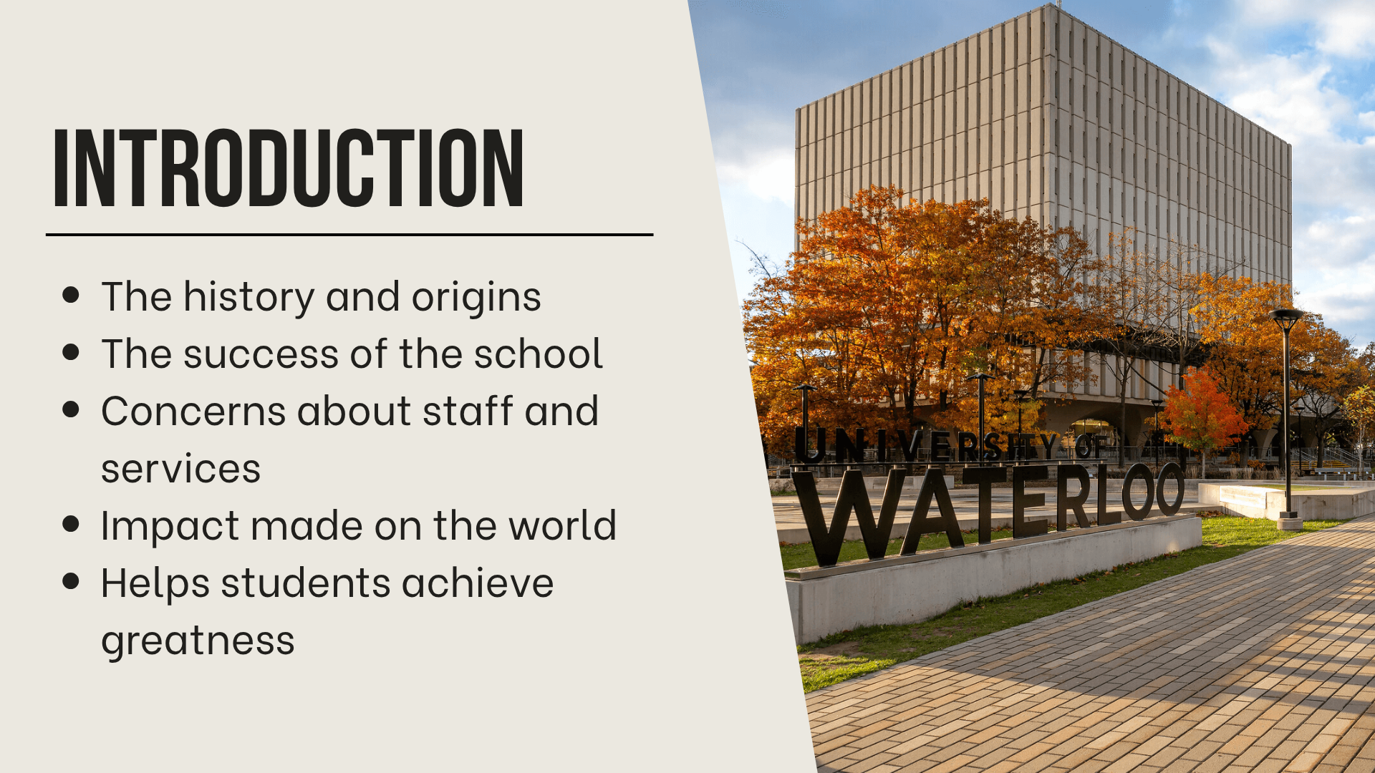
Notes:
It’s no secret that the University of Waterloo is one of the best schools in Canada. On the surface, it is known for its outstanding computer and engineering programs, as well as its fantastic co-operative education program, but its history and origins are not as known. The university started in a parking lot, with its first faculty being engineering. Today, it is an internationally recognized school, improving research, education and resources every single year. Although the university is an remarkable school, there have been some struggles along the way, including mental health and service concerns that have been voiced by students. Overall, the outcomes and impact of the school on students has been tremendous, by aiding students in pursuing their passion and being there every step of the way, the University of Waterloo helps change the world for the better.

Slide 3
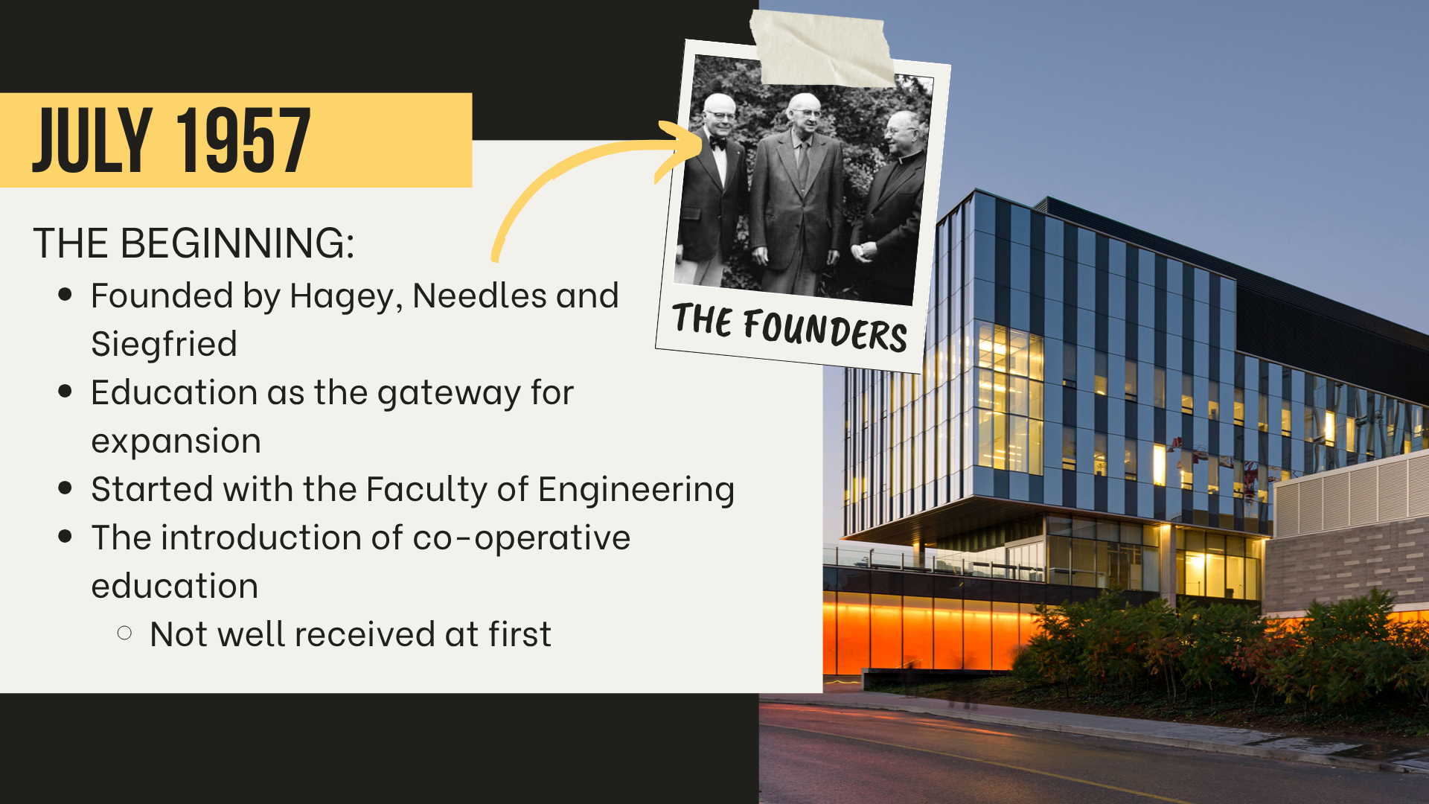
Notes:
The University of Waterloo was founded post WW2, by Gerald Hagey, Ira Needles and Reverend Cornelius Siegfried who believed that education was the way to expand Canada post-war. The first faculty was Engineering, with a class of 74 students, being taught in portables in a parking lot. It wasn’t much, but the determination and passion of the students and educators is what kept the school running, and turned it into the internationally awarded school it is today. When the university first opened, Albert S. Barber introduced the idea of co-operative education so students can learn not only through taught knowledge, but experience as well. Although at the time, the public was “skeptical and thought [co-op] could threaten universities” (Salib), the co-op program is now one of the main factors of attraction for Waterloo.

Slide 4
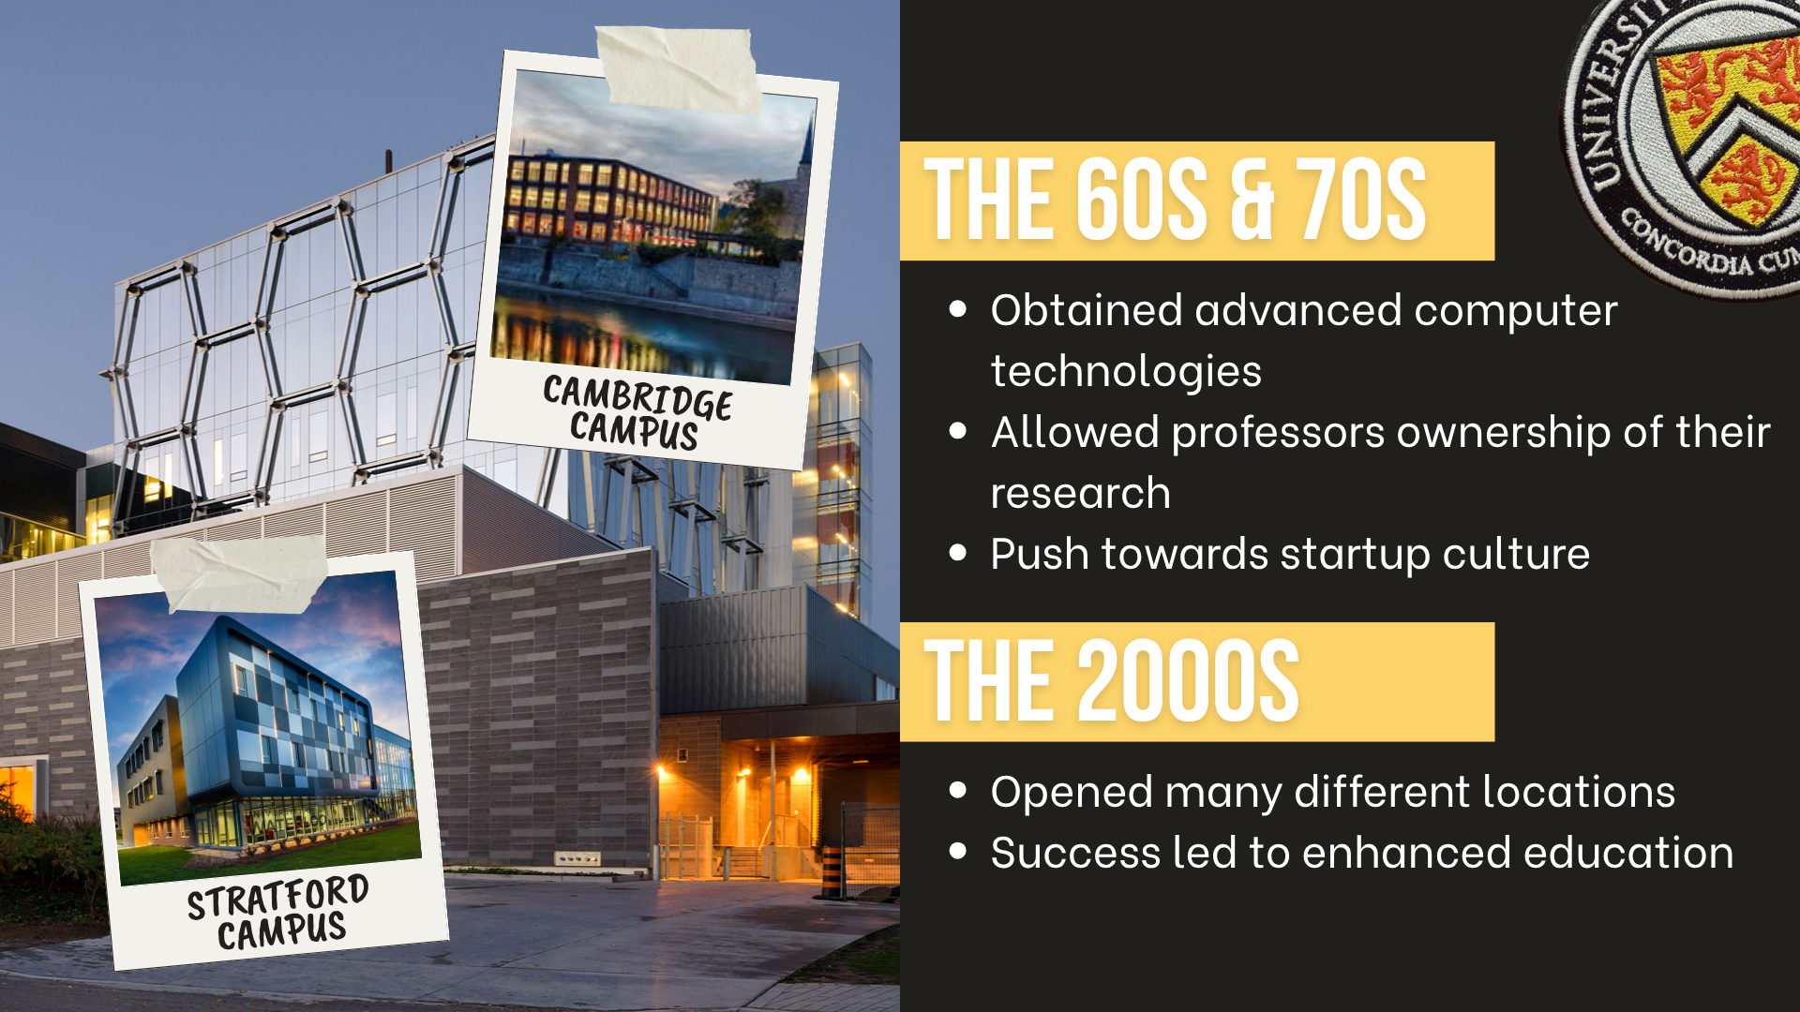
Notes:
In the 60s, computer science teacher Wes Graham pushed the university to invest in new computers. He believed that accessibility to new and efficient technologies “would propel [students] forward in their education and research” (Salib). Due to his insistence, the University of Waterloo became one of the first universities with access to the latest technologies (at the time) and now has one of the best computer science programs in the world. A decade later, the university started giving professors ownership of their own research, which helped push the startup culture that is still apparent within the school to this day. The university encounters extraordinary success as the years go on, opening multiple locations in Ontario in the 2000s, including Cambridge, Kitchener and Stratford. The success of the school allowed for improved education, resources and research.

Slide 5
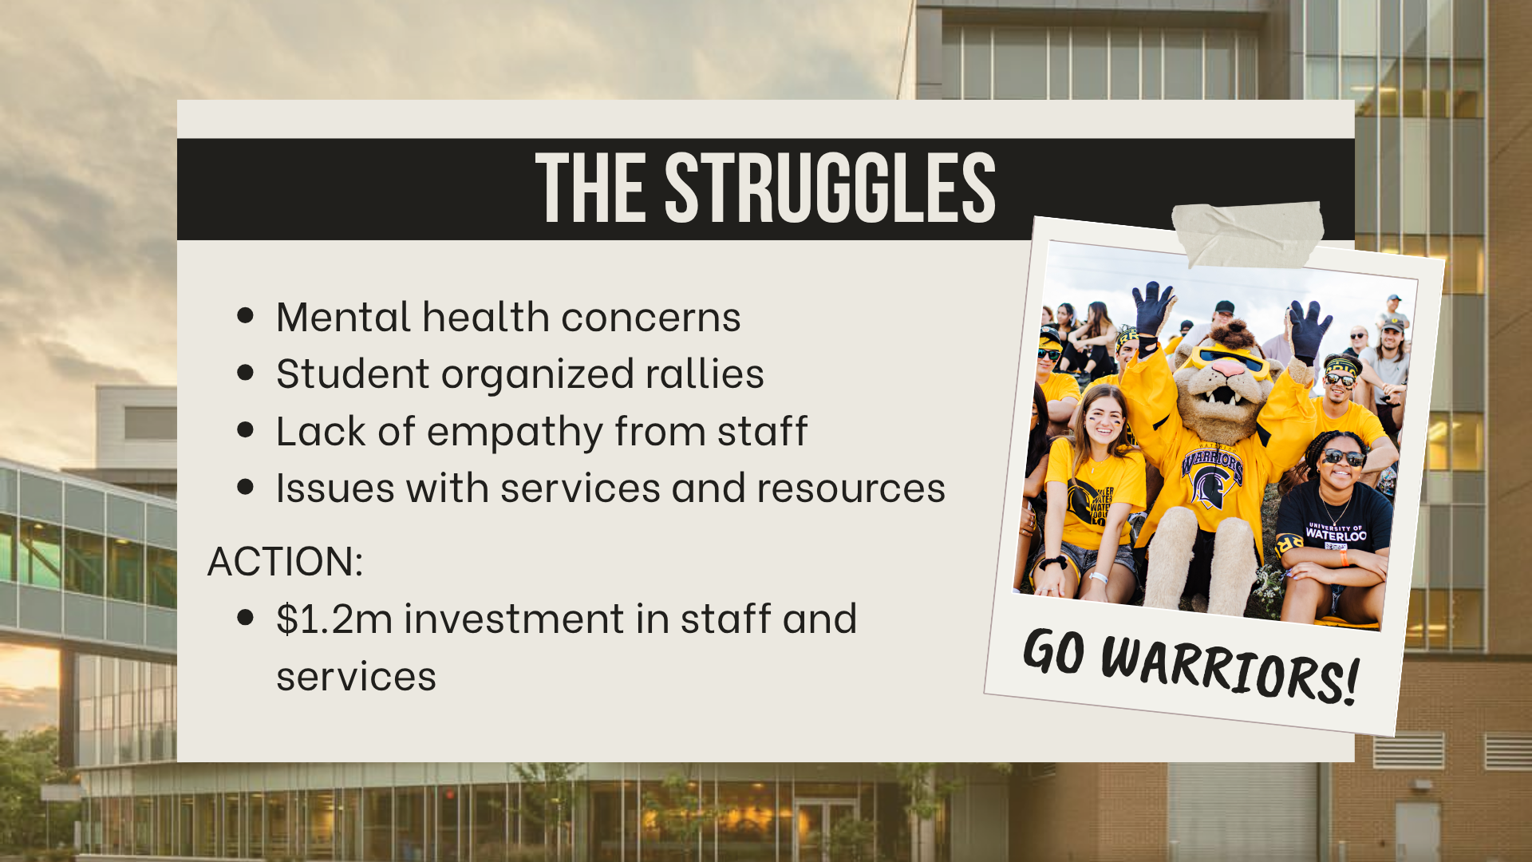
Notes:
In recent years, there has been an increase in mental health concerns for students due to stress, with rallies being organized by students to raise awareness about the mental health issues within the school. A student interviewed by the Waterloo Chronicle says that the professors are a lot more understanding and accessible at the other universities he has attended, compared to Waterloo, and adds that out of the universities he has attended, “Waterloo ranks the highest in terms of student stress” (Jackson). Additionally, many students have expressed their concern about their unsatisfactory experience with staff and services. According to a Maclean survey done about the university, “75 per cent of respondents [ranks] the school’s supports as either fair or poor” (Flanagan). In response to the struggles and concerns, the school has invested $1.2 million to increase mental health training for staff, and to improve the counselling services department.

Slide 6
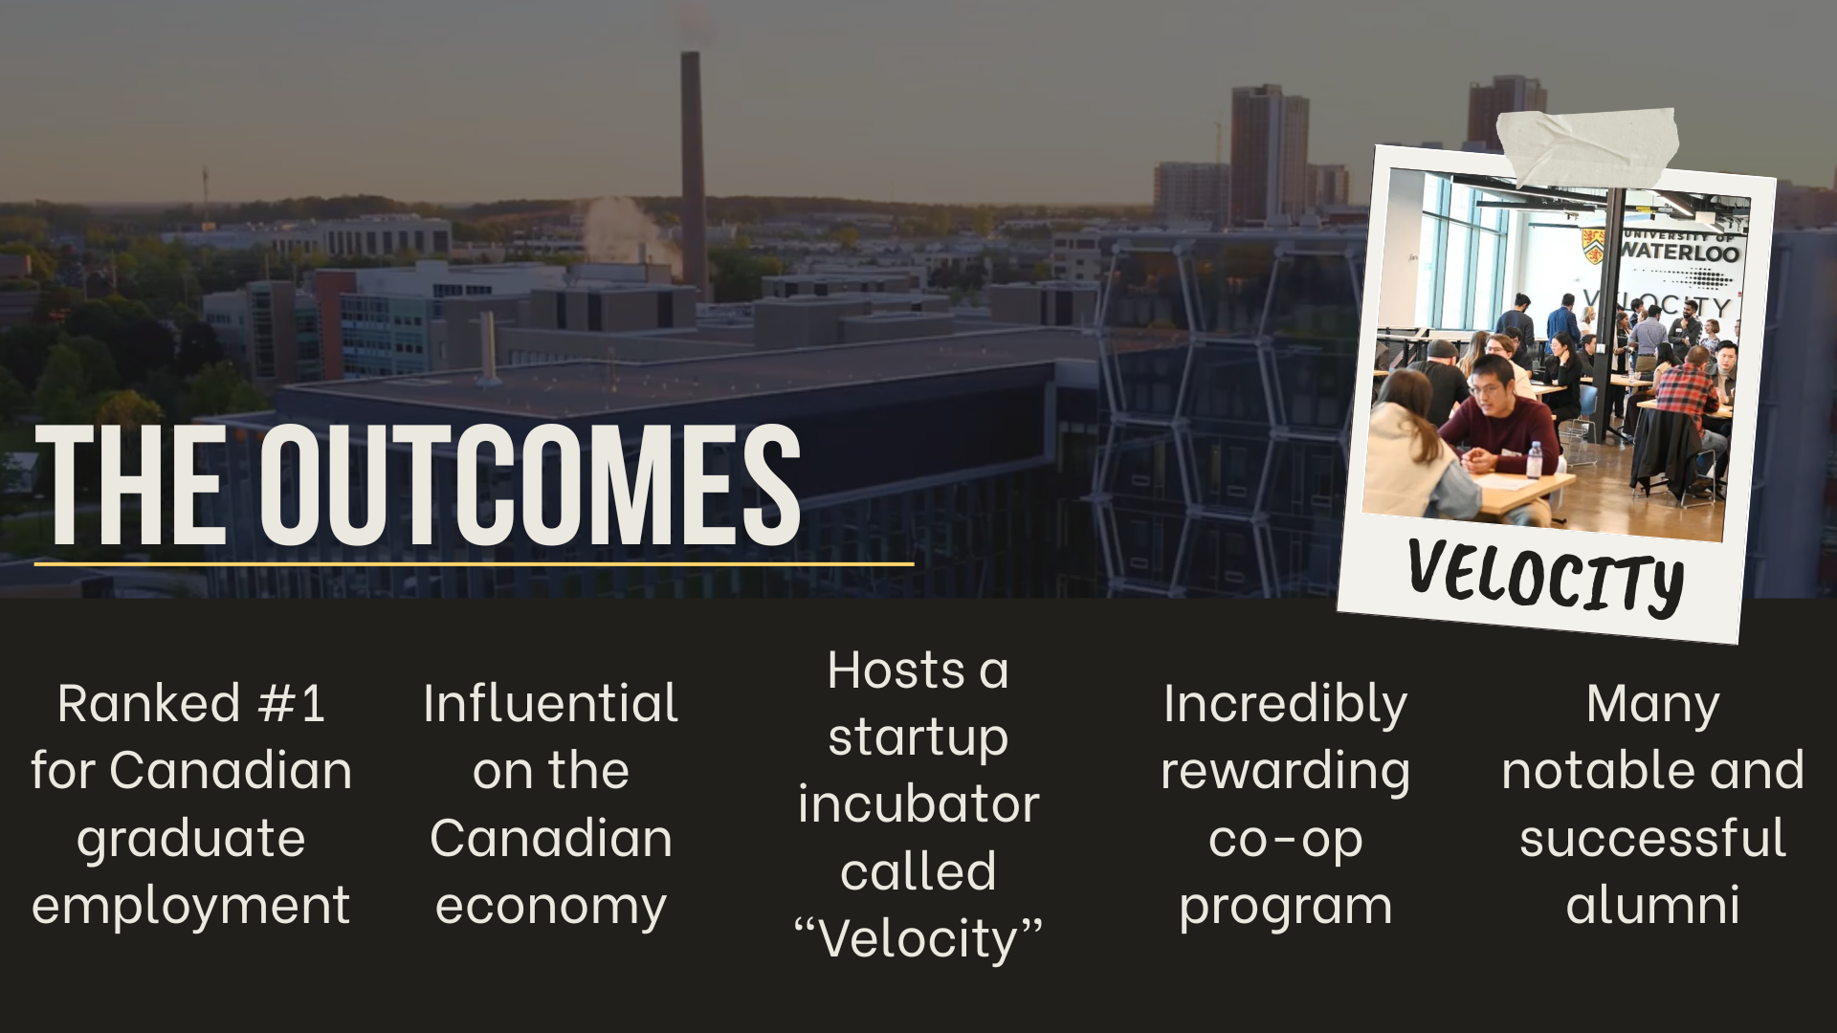
Notes:
There are many notable names that have come from the University of Waterloo, including Kevin O’Leary, investor and TV personality, Donna Strickland, the 2018 Physics Nobel Prize winner and Mike Lazaridis, founder of BlackBerry, which was founded in the city of Waterloo. Students have also found success within the co-op program, earning an average of $14k within one co-op term. The university is also known for its startup environment, and hosts Velocity, “the largest free startup incubator in the world” (Charity Intelligence Canada). The success of Velocity has been monumental, raising over $26 billion USD in value, adding $170 million to Canada’s GDP, and creating over 7500 jobs. Not only do students reach success while in school, but post graduation as well. The university is ranked #1 in Canada for graduate employment, with 92% of graduates being employed within 6 months of graduating, and 96% being employed after 2 years.

Slide 7
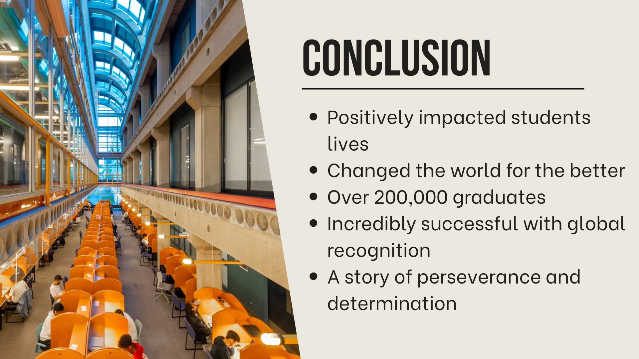
Notes:
In conclusion, the University of Waterloo has not only had an impactful change on students' lives, but on the world as well. It has definitely left its mark on the world since its humble beginnings in a parking lot with only 74 students. Today, there are over 200,000 Waterloo graduates all over the world, making a change for the better and following their passions with the help of the university. Despite the challenges faced, the perseverance and determination of the school led to its success and global recognition. The story of the University of Waterloo is one of dedication, achievement and hard work and much like its students, it is an unstoppable force bringing change into the world and revolutionizing industries with no plans on stopping anytime soon.

Slide 8
